Slide 1
Adrenal Insufficiency Training
Sarah Sparks, MSN, CRNP, FNP-C
&
Leslie Pitts, MSN, CRNP, CPNP-AC, CDCES

Slide 2
Objectives
After completion of this training, the learner will be able to:
1 | Describe adrenal gland function.
2 | Recall adrenal pathophysiology and pharmacology.
3 | Manage adrenal insufficiency appropriately.
4 | Dose and administer Solu-Cortef emergency injection for adrenal crisis events.

Slide 3
Adrenal Insufficiency School Training
Alabama Senate Bill 52
Amended the Alabama Safe Schools Act.
Mandates adrenal insufficiency and adrenal crisis training for school staff.
Authorizes trained school personnel to administer injectable medication to students with adrenal crisis.
Alabama Health Services Safe Schools Adrenal Insufficiency Curriculum
Notes:
Ensures that the school system addresses the medical needs of students with adrenal insufficiency and prohibits their exclusion from activities due to their condition.

Slide 4
The Adrenal Glands
The adrenal glands are small organs that rest on the upper poles of the kidneys.
Each adrenal gland is composed of two distinct parts:
The Adrenal Cortex
The Adrenal Medulla

Slide 5
The Adrenal Cortex
The three main adrenal hormones are:
Mineralocorticoids = Aldosterone
Glucocorticoids = Cortisol
Adrenal Androgen = Dehydroepiandrosterone (DHEA)
All adrenocortical hormones are steroid compounds derived from cholesterol.

Slide 6
Glucocorticoids
Approximately 95% of glucocorticoid activity comes from cortisol.
In normal situations, CRH, ACTH, and cortisol secretory rates demonstrate a circadian rhythm.
Peak- early morning (6-8 AM)
Trough – evening (10 PM - 2 AM)
Stressors also increase cortisol secretion.
Notes:
Dose hydrocortisone 3-4 times per day to mimic the body’s natural cortisol response

Slide 7
Increases and sustains blood glucose by stimulating gluconeogenesis in the liver and decreasing glucose use in the body.
Cortisol
Anti-inflammatory effects
Decreases eosinophils and lymphocytes
Notes:
Cortisol= increases blood glucose, is anti-inflammatory, can suppress immune system over time

Slide 8
Glucocorticoids
Deficiency
Excess
Hypoglycemia
Nausea, Vomiting
Fatigue
Muscle Weakness
Hypertension
Weight Gain
Poor Growth
Stria
Sleep Disturbance
Anxiety
Menstrual Irregularity

Slide 9
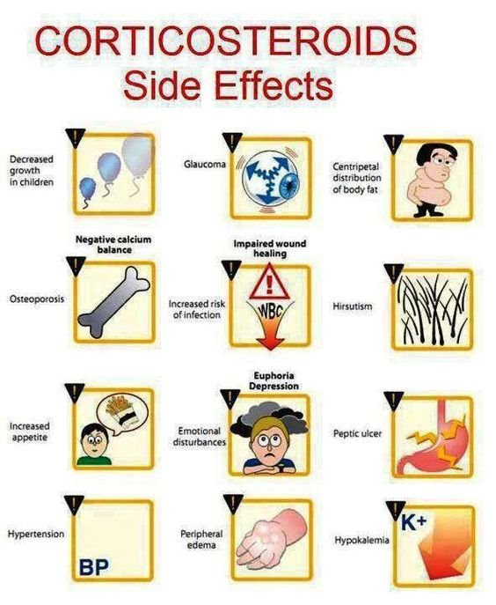
Steroid Risks
Poor Growth
Increased Weight Gain
Decreased Bone Mineral Density
Hypertension
Adrenal Suppression

Slide 10
Mineralocorticoids
Aldosterone accounts for 90% of mineralocorticoid activity
Aldosterone promotes sodium reabsorption and potassium excretion
Aldosterone also affects sodium absorption in the intestine, especially the colon.
Without aldosterone, the kidney loses excessive amounts of sodium and water.

Slide 11
Mineralocorticoids
Deficiency
Excess
Weight Loss
Fatigue
Nausea, Vomiting, Anorexia
Salt-Craving
Hypotension
Hyperkalemia, Hyponatremia
Metabolic Acidosis with Normal Anion Gap
Hypertension
Elevated Sodium
Low Potassium
High Calcium
Fatigue
Headache
Muscle Weakness
Notes:
Mineralocorticoid deficient= “salt wasting”

Slide 12
Adrenal Androgens
The adrenal cortex continually secretes male sex steroid hormones:
DHEA
DHEA-Sulfate (DHEAS)
Androstenedione
11-Hydroxyandrostenedione
These hormones are converted to testosterone.
Play a role in the onset of puberty.

Slide 13
Adrenal Androgens
Deficiency
Excess
Decreased Pubic and Axillary Hair
Under-virilized 46,XY Male
Premature Adrenarche
Acne
Body Odor
Advanced Bone Age
Precocious Puberty
Virilization of 46,XX female

Slide 14
Adrenal Medulla
Epinephrine - 80%
Norepinephrine - 20%
Function:
Increase cardiac output and vascular resistance
Physiologic stress response
Minimal amounts of Dopamine
Notes:
“Fight or flight” response to stress
CAH does not usually affect the medulla, however, low cortisol levels can lead to lower levels of epinephrine

Slide 15
HPA Axis and Glucocorticoid Regulation
Notes:
Cortisol production and release is regulated by the pituitary gland in the brain. The pituitary gland senses how much cortisol is in the blood stream. If there is too little, it releases a hormone called ACTH, which tells the adrenal glands to make more cortisol. If there is too much cortisol, the brain releases less ACTH, which in turn, decreases cortisol

Slide 16
Types of Adrenal Insufficiency
Primary Adrenal Insufficiency
Affects 10-15 per 100K individuals
Causes include:
Impaired steroid synthesis (CAH)
Adrenal destruction/dysfunction (ALD, Addison’s disease)
Notes:
Primary Adrenal Insufficiency
Affects 10-15 per 100K individuals
Causes include:
Impaired steroid synthesis (CAH)
Adrenal destruction/dysfunction (ALD, Addison’s disease)
Central AI
Congenital
Acquired
Sellar mass
Infiltrative
Autoimmune
Traumatic brain injury
6

Slide 17
Types of Adrenal Insufficiency
Central Adrenal Insufficiency
Secondary and tertiary AI
150-280 per 1M individuals
Congenital
Genetic
Acquired
Sellar mass
Infiltrative
Autoimmune
Traumatic brain injury
Tertiary Adrenal Insufficiency
Secondary Adrenal Insufficiency
Notes:
Primary Adrenal Insufficiency
Affects 10-15 per 100K individuals
Causes include:
Impaired steroid synthesis (CAH)
Adrenal destruction/dysfunction (ALD, Addison’s disease)
Central AI
Congenital
Acquired
Sellar mass
Infiltrative
Autoimmune
Traumatic brain injury
6

Slide 18
Treatment of adrenal insufficiency includes daily oral hydrocortisone replacement to mimic the body’s natural stress response. This is called a “maintenance dose” and is divided every 8 hours.
During times of fever, vomiting/diarrhea, trauma (i.e., broken bone), or surgery, children with adrenal insufficiency will need a “stress dose.” This is typically double or triple the maintenance dose, depending on the severity.
Patients who are also deficient in aldosterone will require replacement with daily oral fludrocortisone. The fludrocortisone dose does not change with stress dosing.
TREATMENT OF ADRENAL INSUFFICIENCY

Slide 19
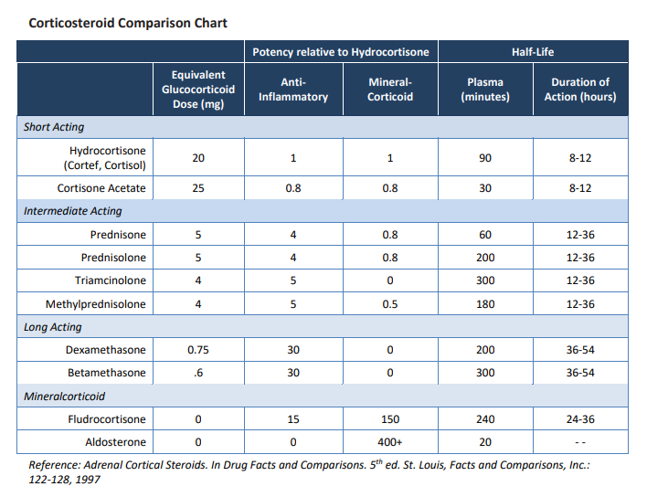
Notes:
main things to highlight are the dosing equivalents and the duration of action (ie prednisone and dex are more potent and longer acting than hydrocortisone)

Slide 20
When?
Illness
Fever > 101
Mild to Moderate Trauma
Seizure
Surgery
How?
Double or triple the maintenance dose.
​
If on stress dosing for > 3 days will need to gradually taper dosing back to maintenance.​
Oral Stress Dosing

Slide 21
EXAMPLES OF ORAL STRESS DOSING

Slide 22
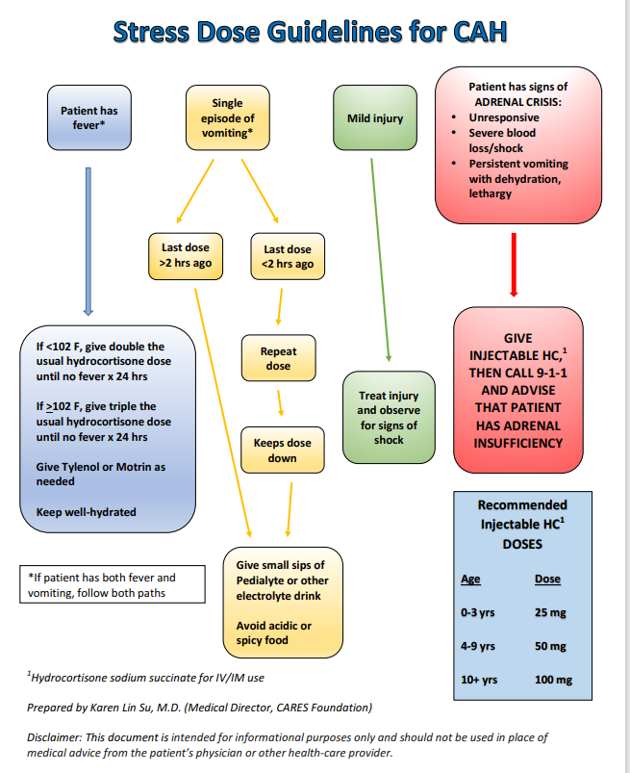
Notes:
From CARES

Slide 23
Emergency Medical Services
Treat underlying cause of crisis per appropriate protocol (i.e. sepsis, fracture, burn)
Cardiac monitor
Check blood glucose, if hypoglycemic treat per hypoglycemia protocol.
Establish IV
Alabama EMS Adrenal Insufficiency Protocol
If patient has personal medications, administer per accompanying instructions. If patient does not have personal medications or dosing instructions, utilize the following:
Hydrocortisone Sodium Succinate
100mg IM or IV
2 mg/kg IM or IV, 100mg max
Methylprednisolone
125mg IM or IV
2 mg/kg IM or IV, 125mg max
Dexamethasone
5mg IM or IV
Current EMS protocols of many states do not :
Address adrenal insufficiency
Allow emergency medical response personnel to treat individuals with medical ID that say “Adrenal Insufficiency”
Administer patient-carried medication used to treat adrenal crisis
Notes:
EMS does not carry Solu-Cortef but can administer if patient has medication with instructions on hand
Most EMS in AL carry Solu-Medrol- which can also be given in the event of an emergency

Slide 24
RESOURCES

Slide 25
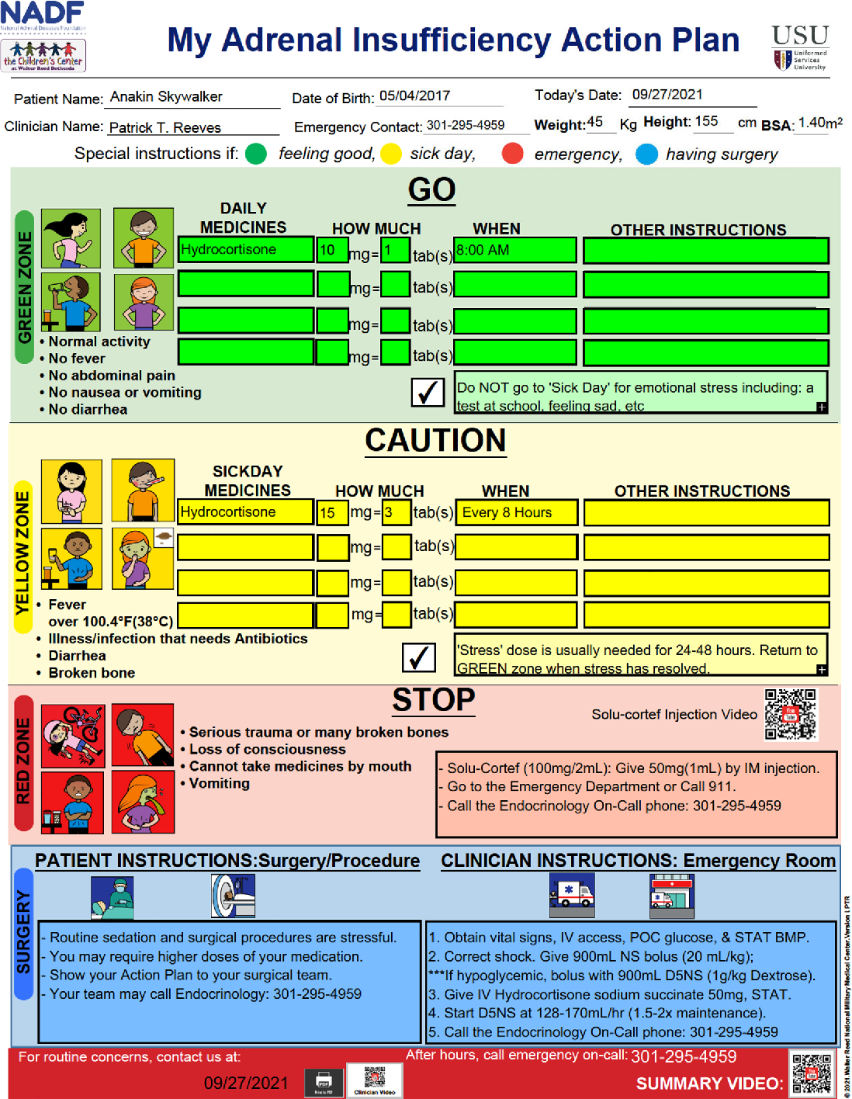
Adrenal Insufficiency Action Plan

Slide 26
Preventing Adrenal Crisis Emergencies with the PACE App
Apple or Android:​ Go to the app store and search: "PACE by ChaiCore"
Available in English or Spanish
​The application is free and does not require cellular data or wireless internet. ​
No data is collected by this application​
​PACE by ChaiCore is a grant-funded research application studying efficacy of Adrenal Crisis content for informing patients about their disease.
Notes:
Created by Dr. Louise Fleming – Professor at UNC School of Nursing
Apple or Android
Does not need cellular data or internet after downloaded

Slide 27
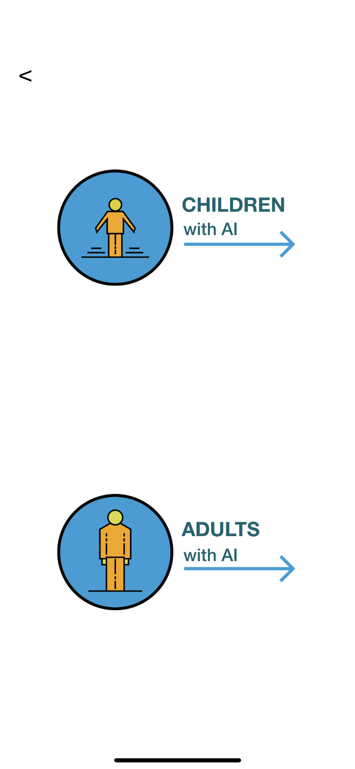
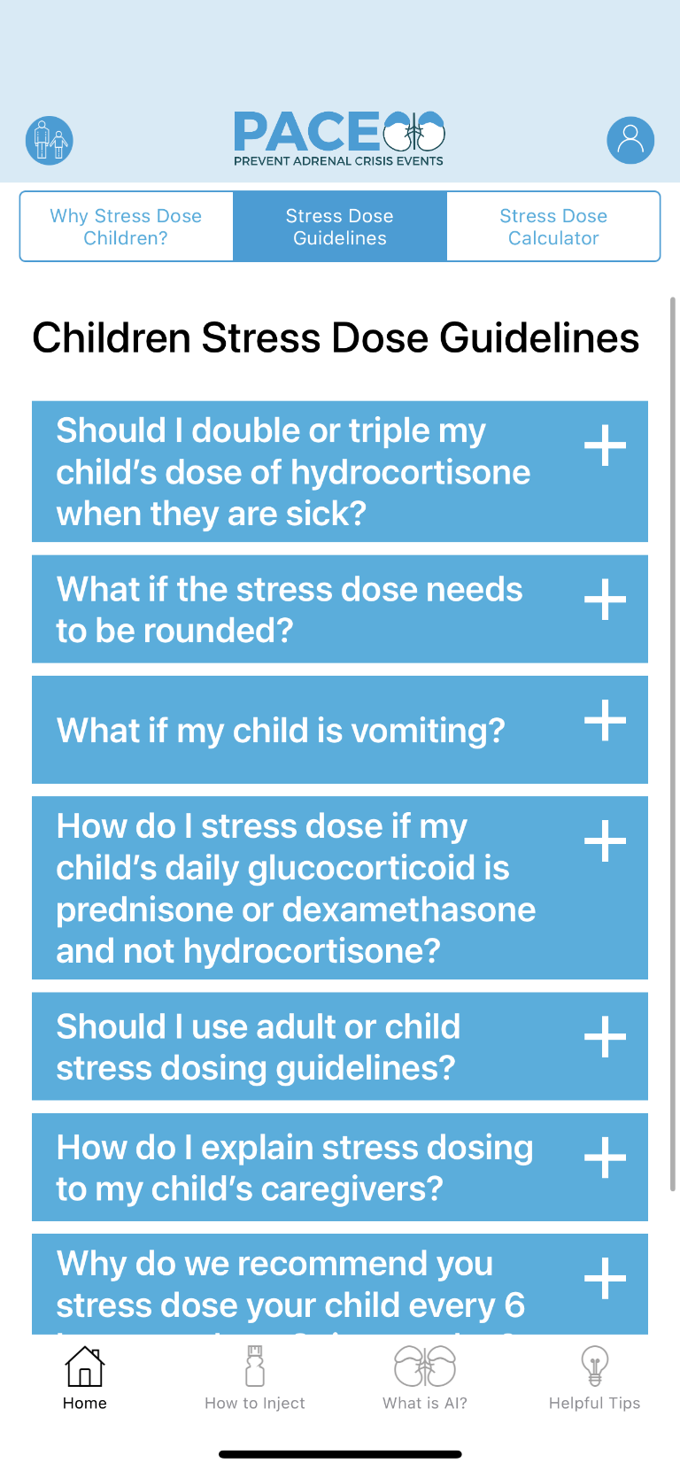
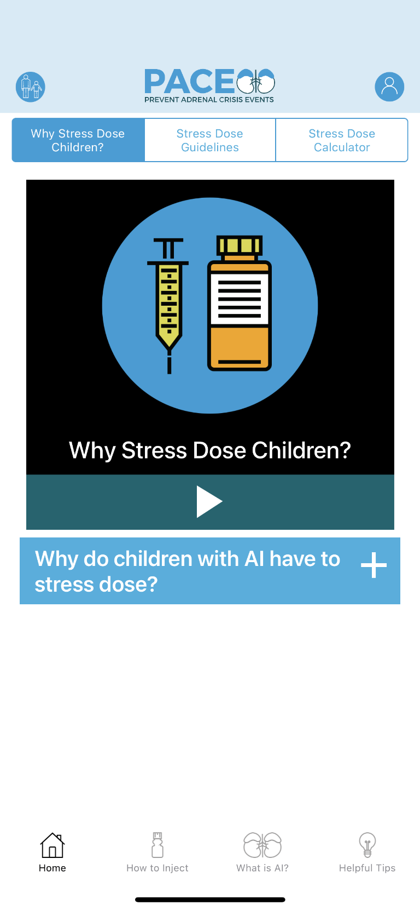

Slide 28
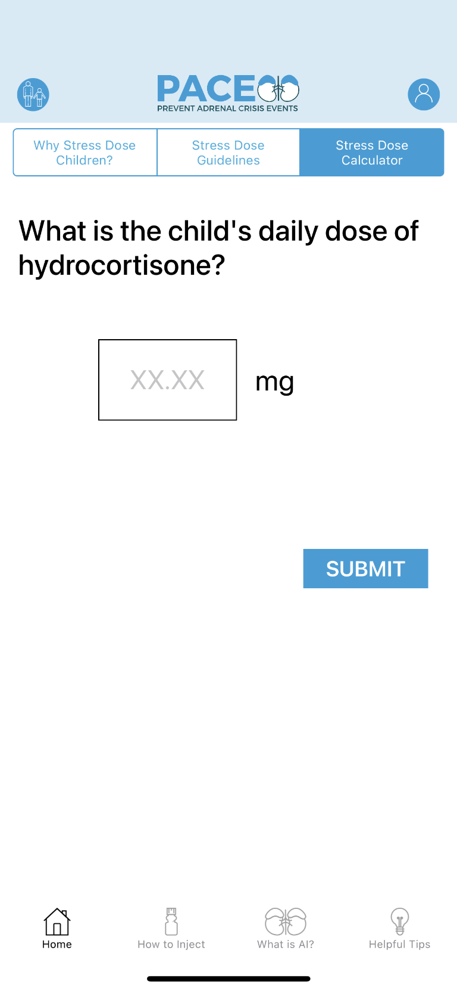
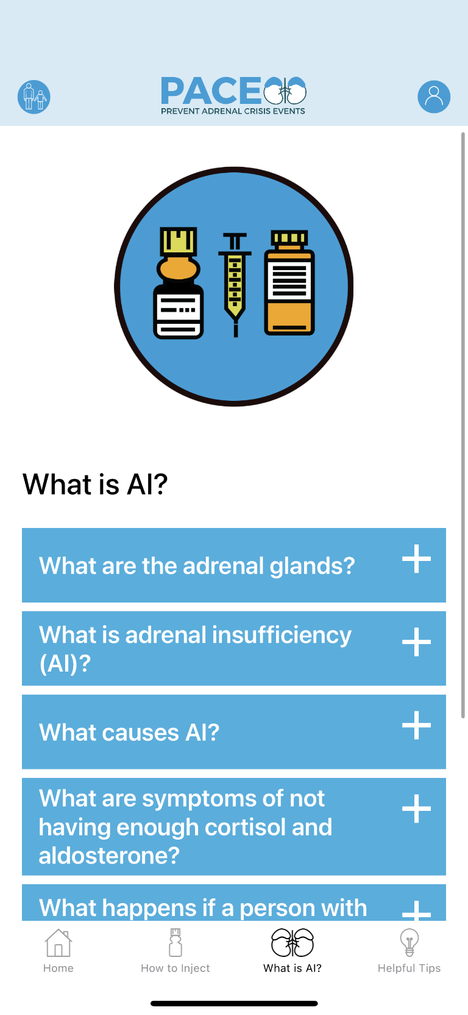
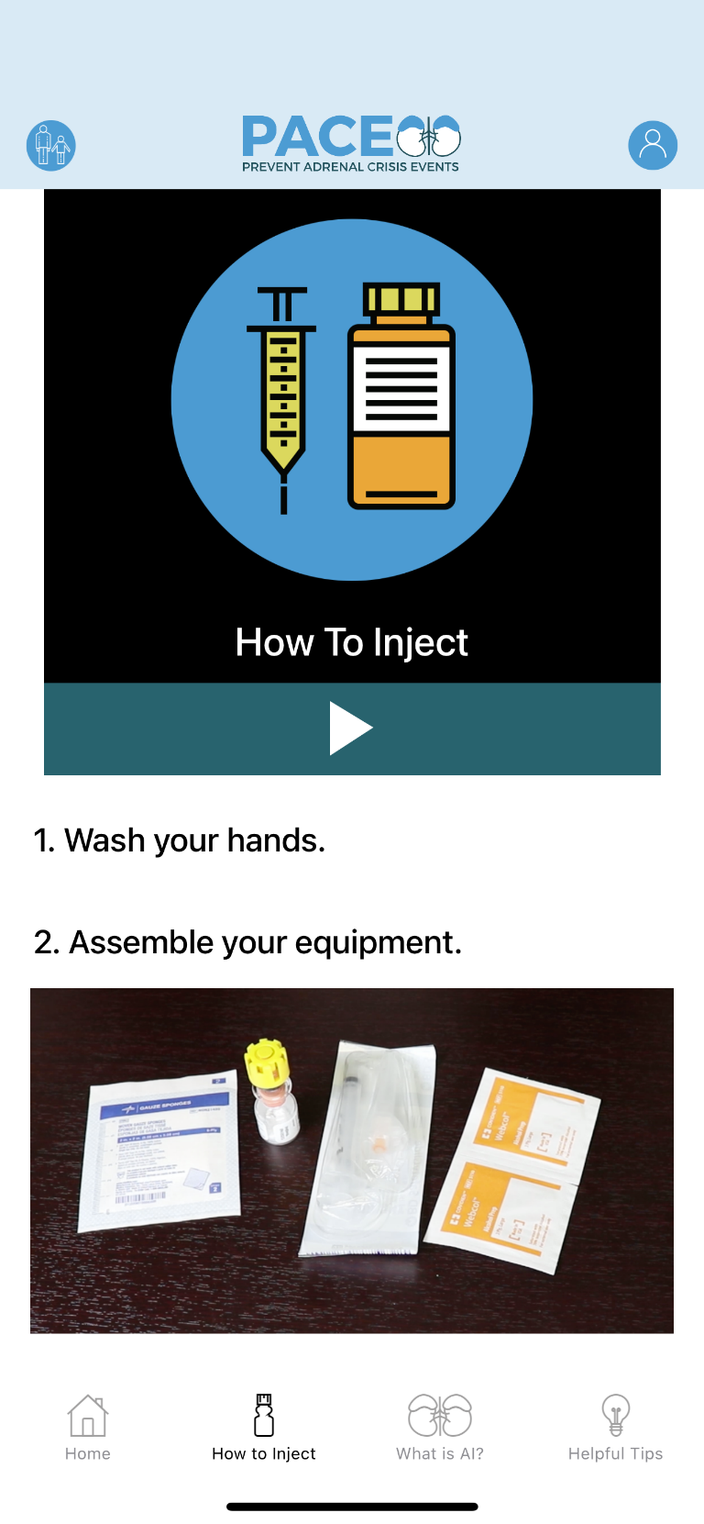

Slide 29
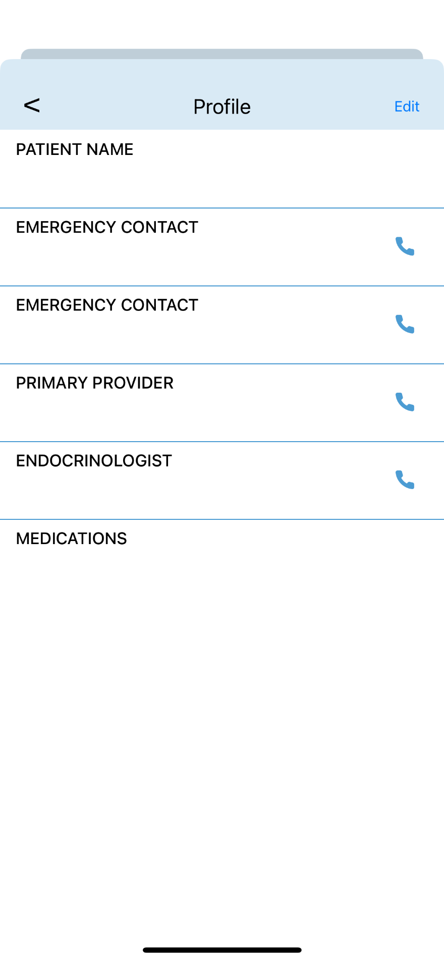
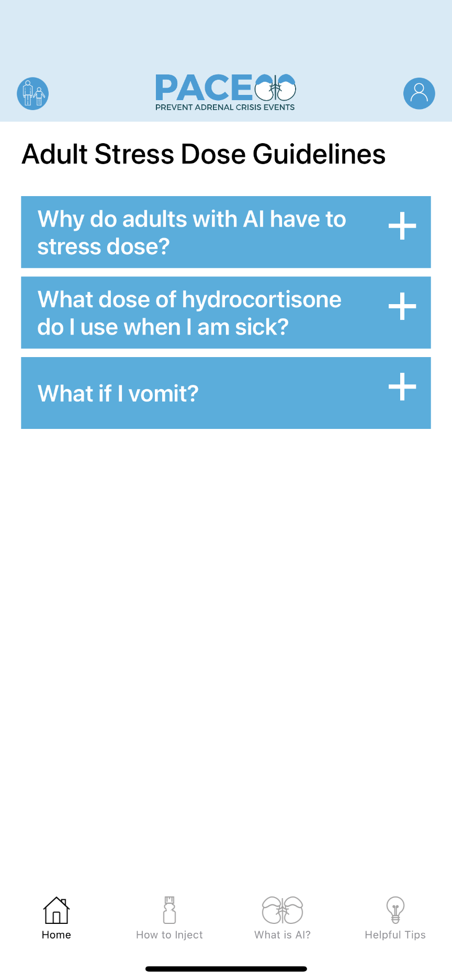

Slide 30
Getting Ready for School/Camp: Parent Tips
Contact your local CARES Support Group Leader to talk with other parents of children with CAH
Get Medical Alert Identification
Build a team
Give yourself time
Keep records/make lots of copies
Bring a friend
Get feedback

Slide 31
504 Plan
A child with classical CAH is at risk of adrenal crisis and requires appropriate monitoring and care to avoid serious illness and possible death
Though CAH is not thought of as a disability, children with classical CAH are at serious risk for an adrenal crisis without proper medication, monitoring of health status, access to water, and appropriate emergency medical response
Parents can advocate for 504 plans for their child to maintain his/her health and welfare

Slide 32
Health Plan Worksheet

Slide 33
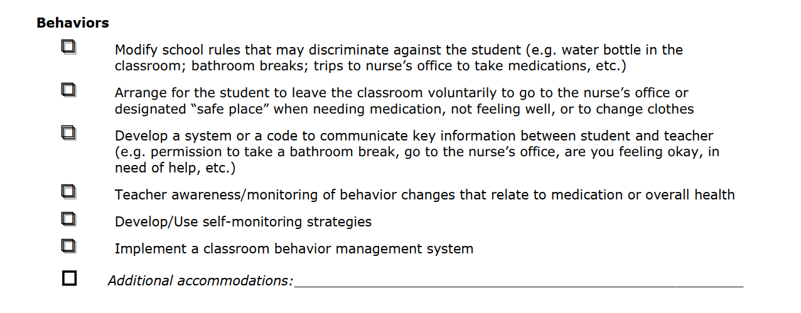
Health Plan Worksheet

Slide 34
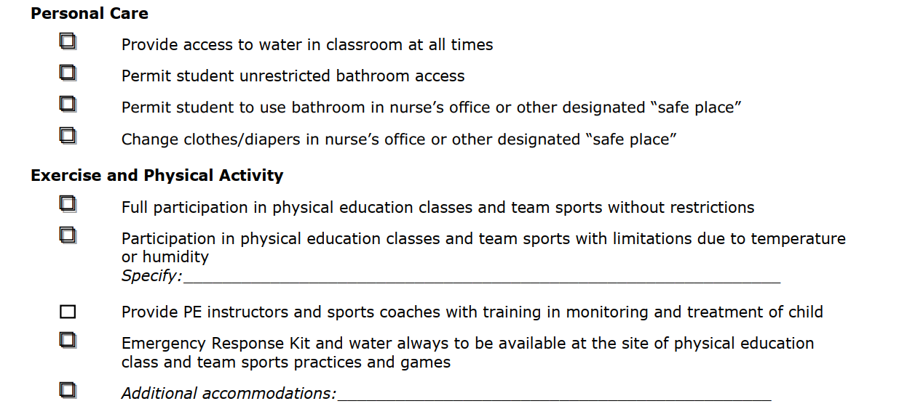
Health Plan Worksheet

Slide 35
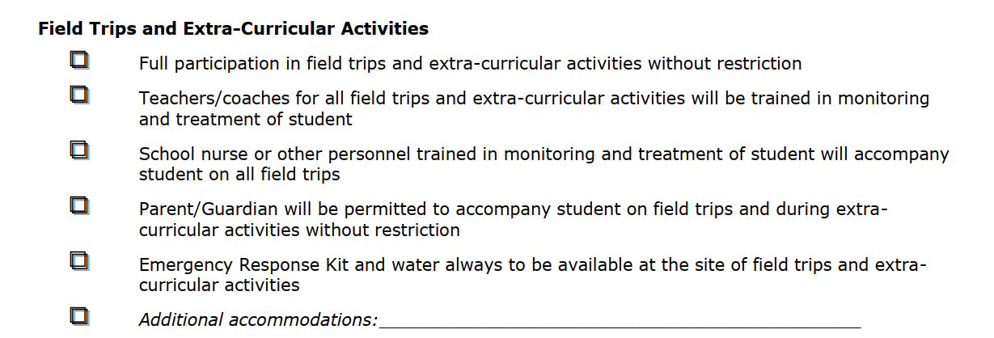
Health Plan Worksheet

Slide 36
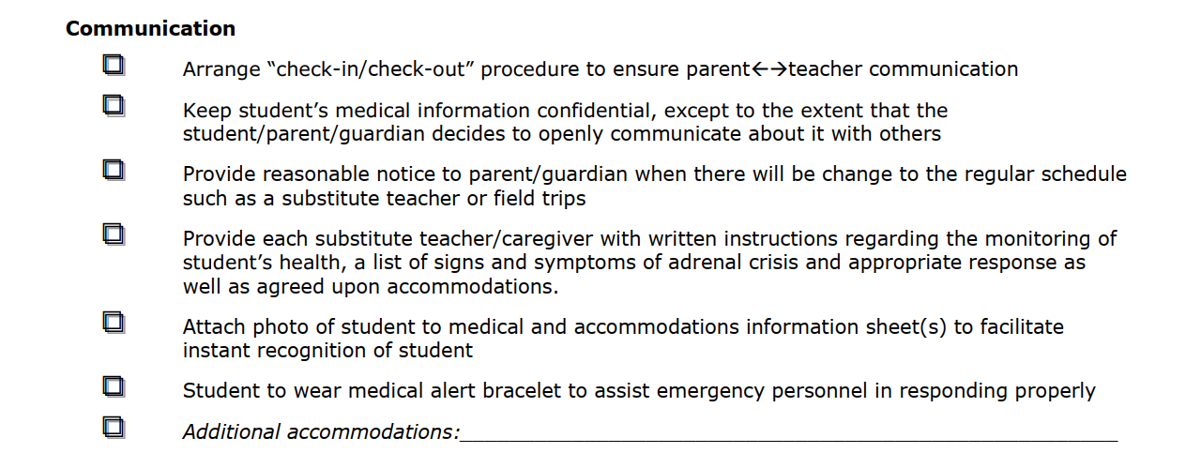
Health Plan Worksheet

Slide 37
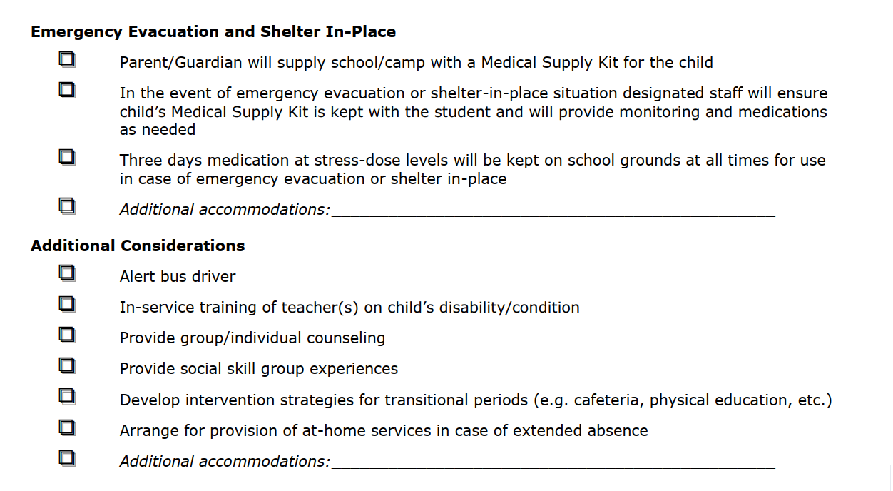
Health Plan Worksheet

Slide 38
Causes of Adrenal Crisis
Unknown adrenal insufficiency
Untreated adrenal insufficiency
Undertreated adrenal insufficiency
Abrupt discontinuation of long-term steroids
Physiological Stress
Vomiting
Diarrhea
Viral or Bacterial Infection
Trauma
Broken Bones
Seizures
Surgery

Slide 39
Adrenal Crisis Symptoms
Nausea/ Vomiting
Dehydration
Hypotension
Shock
Acute Abdominal Pain
Hypoglycemia
Hyponatremia
Hyperkalemia
Hypercalcemia
Fatigue
Anxiety
Weakness

Slide 40
What does adrenal crisis look like?

Slide 41
Solu-Cortef injections are given for two basic reasons:
Unable to absorb the oral dose (vomiting, repeated diarrhea)
Decreased level of consciousness
Prescription:
Act-O-Vial 100mg/2ml.
DOSE: 25mg, 50mg, or 100mg
Frequency: As needed
Adrenal Emergency Medication
Intramuscular
Solu-Cortef
(hydrocortisone sodium succinate)

Slide 42
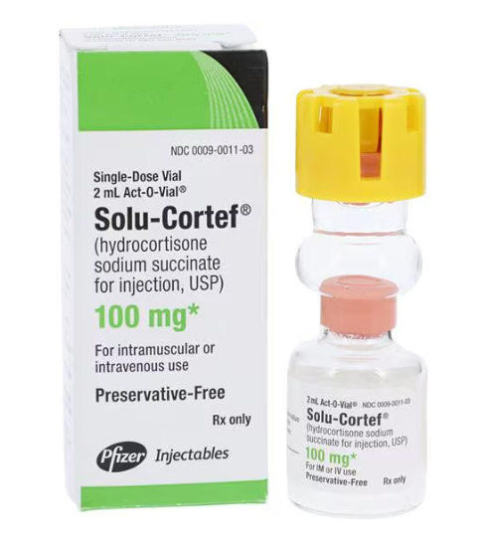
Ensuring the Effectiveness and Safety of Solu-Cortef
Storage and Stability
Room temperature (59-77ºF) before reconstitution.
Protect from light and moisture to maintain stability. Do not freeze.
Check the expiration date printed on the vial or packaging. Do not use the medication past this date as it may not be effective or safe.
Once reconstituted, Solu-Cortef solution should be used immediately.
If not used immediately, Solu-Cortef should be stored in the refrigerator (36-46ºF) and used within 3 days (72 hours). After this period, it should be discarded.
Additional Notes
Visual Inspection: Before administration, inspect the reconstituted solution for any particulate matter or discoloration. If either is present, do not use the solution.
Handling: Always use aseptic techniques when handling and reconstituting the medicine to avoid contamination.
Notes:
Side effects= stomach upset, headache, dizziness
Does NOT cause vomiting like glucagon can

Slide 43
Administering Solu-Cortef
Start Video at 6:50
Stop at 9:24

Slide 44
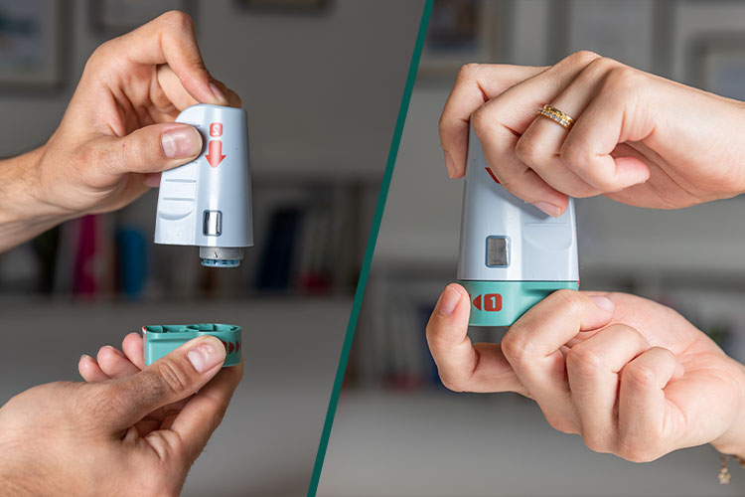
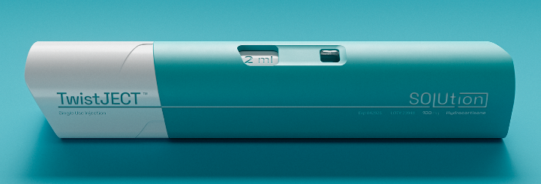
Future of Solu-Cortef
Emergency Administration
CrossJet’s Zeneo®
Prefilled, automatic, disposable needle-free jet injector
SOLUtion Pre-filled Syringe
SOLUtion Medical TwistJectTM

Slide 45
Questions

Slide 46
Cares Foundation, Emergency instructions brochure.
https://caresfoundation.org/wp-content/uploads/2022/08/EMERG-INSTRUCTIONS-BROCHURE-8.5.22.pdf
Fleming, L. (2020). Preventing Adrenal Crisis Events (PACE) [Mobile health application]. Retrieved September 28, 2022 from https://apps.apple.com/ae/app/pace-by-chaicore/id1490431010?platform=ipad
Fleming, L. K., Rapp, C. G., & Sloane, R. (2011). Caregiver knowledge and self-confidence of stress dosing of hydrocortisone in children with congenital adrenal hyperplasia. Journal of Pediatric Nursing, 26(6), e55-60. https://doi.org/10.1016/j.pedn.2011.03.009
Kappy, M.S., Allen, D.B., and Geffner, M.E. (2010). Pediatric practice: Endocrinology. New York: McGraw Hill Medical.
Babler, E.K., Betts, K.J., Courtney, J.A., Flores, B.M., Flynn, C., et. al. (2013). Clinical handbook of pediatric endocrinology (2nd Ed.). Quality Medical Publishing, Inc.
Martin-Grace, J., Dineen, R., Sherlock, M., & Thompson, C. J. (2020). Adrenal insufficiency: Physiology, clinical presentation and diagnostic challenges. Clinica Chimica Acta, 505, 78-91. https://doi.org/10.1016/j.cca.2020.01.029
Miller, B. S., Spencer, S. P., Geffner, M. E., Gourgari, E., Lahoti, A., Kamboj, M. K., Stanley, T. L., Uli, N. K., Wicklow, B. A., & Sarafoglou, K. (2020). Emergency management of adrenal insufficiency in children: Advocating for treatment options in outpatient and field settings. Journal of Investigative Medicine, 68(1), 16-25. https://doi.org/10.1136/jim-2019-000999
NADF, Corticosteroid comparison chart. https://www.nadf.us/uploads/1/3/0/1/130191972/corticosteroid_comparison_chart.pdf
Rushworth, R. L., Torpy, D. J., & Falhammar, H. (2019). Adrenal Crisis. The New England journal of medicine, 381(9), 852-861. https://doi.org/10.1056/NEJMra1807486
Widmaier, E.P., Raff, H., Strang, K.T. (2014). Vander’s human physiology: The mechanisms of body function. McGraw-Hill.
References

